Slide 1
Bayesian Network
Il-Chul Moon
Dept. of Industrial and Systems Engineering
KAIST
icmoon@kaist.ac.kr

Slide 2
Weekly Objectives
Know and memorize the theorems of probability
  Recover the probability concepts
  Recover the probability theorems
  Recover the concepts of the marginal and the conditional independencies
Understand Bayesian networks
  Know the syntax and the semantics of Bayesian networks
  Know how to factorize Bayesian networks
  Able to calculate a probability with given conditions
Understand the inference of Bayesian networks
  Able to calculate parameters of Bayesian networks
  Able to list the exact inference of Bayesian networks

Slide 3
Bayesian network

Slide 4
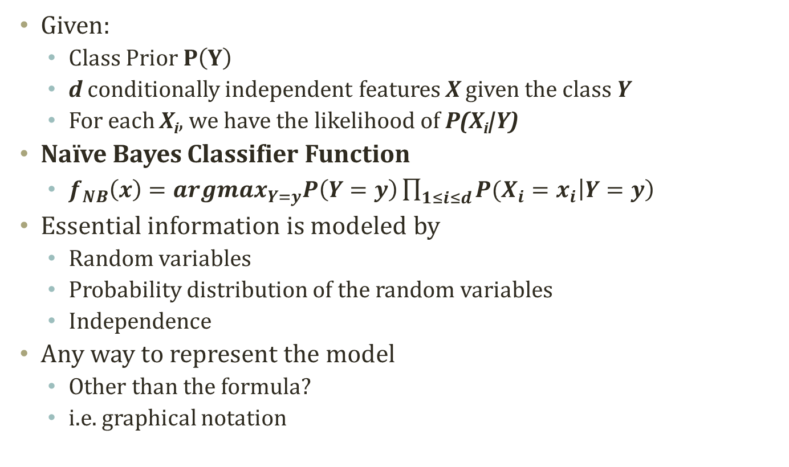
Detour: Naïve Bayes Classifier
Given:
  Class Prior $P\left(Y\right)$
  d conditionally independent features X given the class Y
  For each X_{i}, we have the likelihood of P(X_{i}|Y)
Naïve Bayes Classifier Function
  $f_{NB}\left(x\right)={argmax}_{Y=y}P\left(Y=y\right)\prod_{1≤i≤d}{P(X_{i}=x_{i}\left|Y=y\right)}$
Essential information is modeled by
  Random variables
  Probability distribution of the random variables
  Independence
Any way to represent the model
  Other than the formula?
  i.e. graphical notation
Y
X₁
X₂

Slide 5
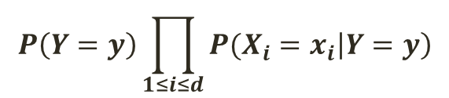
Bayesian Network
$$P\left(Y=y\right)\prod_{1≤i≤d}{P(X_{i}=x_{i}\left|Y=y\right)}$$
A graphical notation of
  Random variables
  Conditional independence
  To obtain a compact representation of the full joint distributions
Syntax
  A acyclic and directed graph
  A set of nodes
    A random variable
    A conditional distribution given its parents
    P (X_{i}|Parents(X_{i}))
  A set of links
    Direct influence from the parent to the child
Graphical Representation
P(Y|Φ)
Y
X₁
X₂
P(X₁|Y)
P(X₂|Y)

Slide 6
Interpretation of Bayesian Network
Topology of network encodes conditional independence assertions
  Often from the domain experts
  What is related to what and how
Interpretation
  Weather is independent of the other variables
  Toothache and Stench are conditionally independent given Cavity
  Cavity influences the probability of toothache and stench
Weather
Cavity
Toothache
Stench

Slide 7
Another Example
P(B)=0.001
P(E)=0.002
Buglary
Earthquake
Scenario
  I'm at work
  Neighbor John calls to say my alarm is ringing
  Neighbor Mary doesn't call.
  Sometimes it's set off by minor earthquakes.
  Is there a burglar?
Variables
  Burglary, Earthquake, Alarm, JohnCalls, MaryCalls
Network topology reflects "causal" knowledge:
  A burglar can set the alarm off
  An earthquake can set the alarm off
  The alarm can cause Mary to call
  The alarm can cause John to call
Alarm
JohnCalls
MaryCalls
A | P(J|A)
T | 0.90
F | 0.05
B | E | P(A|B,E)
T | T | 0.95
T | F | 0.94
F | T | 0.29
F | F | 0.001
A | P(M|A)
T | 0.70
F | 0.01

Slide 8
Components of Bayesian Network
P(B)=0.001
P(E)=0.002
Buglary
Earthquake
Qualitative components
  Prior knowledge of causal relations
  Learning from data
  Frequently used structures
  Structural aspects
Quantitative components
  Conditional probability tables
  Probability distribution assigned to nodes
Probability computing is related to both
  Quantitative and Qualitative
Alarm
JohnCalls
MaryCalls
A | P(J|A)
T | 0.90
F | 0.05
B | E | P(A|B,E)
T | T | 0.95
T | F | 0.94
F | T | 0.29
F | F | 0.001
A | P(M|A)
T | 0.70
F | 0.01

Slide 9
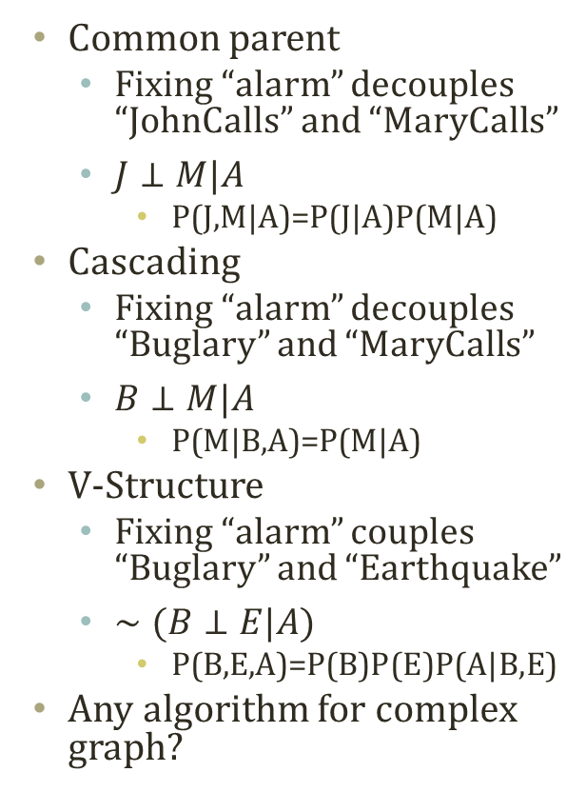
Typical Local Structures
P(A,B)=P(A)P(B)
P(A|B)=P(A)
Alarm
Common parent
  Fixing “alarm” decouples “JohnCalls” and “MaryCalls”
  $J⊥M|A$
    P(J,M|A)=P(J|A)P(M|A)
Cascading
  Fixing “alarm” decouples “Buglary” and “MaryCalls”
  $B⊥M|A$
    P(M|B,A)=P(M|A)
V-Structure
  Fixing “alarm” couples “Buglary” and “Earthquake”
  $∼(B⊥E|A)$
    P(B,E,A)=P(B)P(E)P(A|B,E)
Any algorithm for complex graph?
JohnCalls
MaryCalls
Common Parent
Buglary
Alarm
MaryCalls
Cascading
Buglary
Earthquake
Alarm
V-Structure

Slide 10
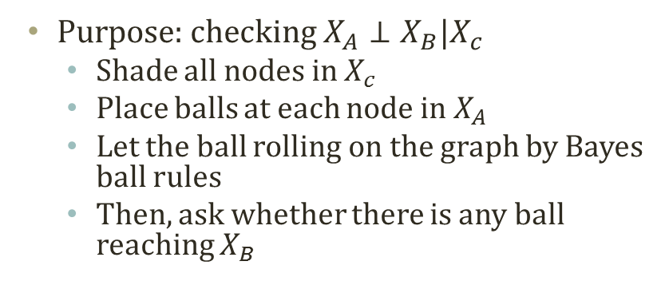
Bayes Ball Algorithm
Purpose: checking $X_{A}⊥X_{B}|X_{c}$
  Shade all nodes in $X_{c}$
  Place balls at each node in $X_{A}$
  Let the ball rolling on the graph by Bayes ball rules
  Then, ask whether there is any ball reaching $X_{B}$

Slide 11
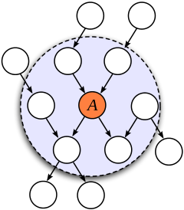
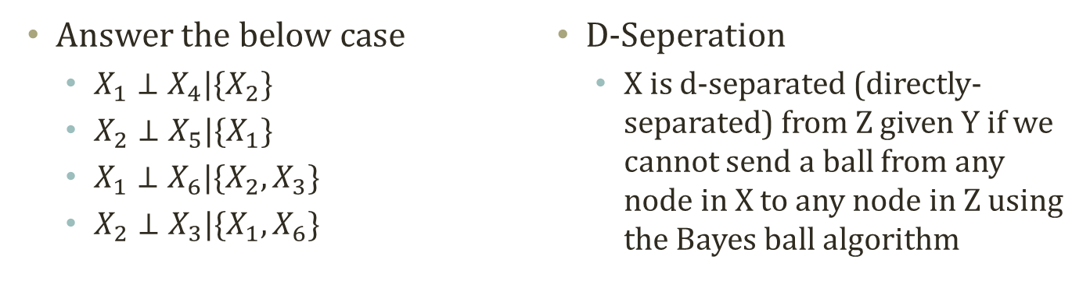
Exercise of Bayes Ball Algorithm
X4
Markov Blanket
P(A|blanket, B)=P(A|blanket)
Blanket={parents, children, children’s other parents}
X2
X1
X6
X3
X5
Answer the below case
  $X_{1}⊥X_{4}|\{X_{2}\}$
  $X_{2}⊥X_{5}|\{X_{1}\}$
  $X_{1}⊥X_{6}|\{X_{2},X_{3}\}$
  $X_{2}⊥X_{3}|\{X_{1},X_{6}\}$
D-Seperation
  X is d-separated (directly-separated) from Z given Y if we cannot send a ball from any node in X to any node in Z using the Bayes ball algorithm

Slide 12
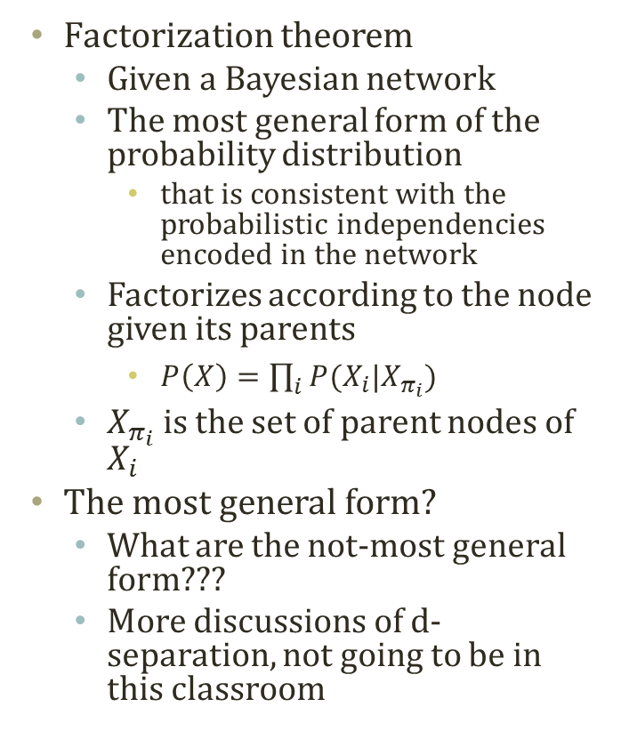
Factorization of Bayesian Network
Factorization theorem
  Given a Bayesian network
  The most general form of the probability distribution
    that is consistent with the probabilistic independencies encoded in the network
  Factorizes according to the node given its parents
    $P\left(X\right)=\prod_{i}{P(X_{i}|X_{π_{i}})}$
  $X_{π_{i}}$ is the set of parent nodes of $X_{i}$
The most general form?
  What are the not-most general form???
  More discussions of d-separation, not going to be in this classroom
X1
X2
X3
X4
X5
X6
X7
X8
P(X1,X2,X3,X4,X5,X6,X7,X8)
=P(X1)P(X2)P(X3|X1)P(X4|X2)P(X5|X2)
P(X6|X3,X4)P(X7|X6)P(X8|X5,X6)

Slide 13
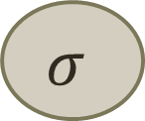
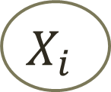
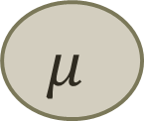
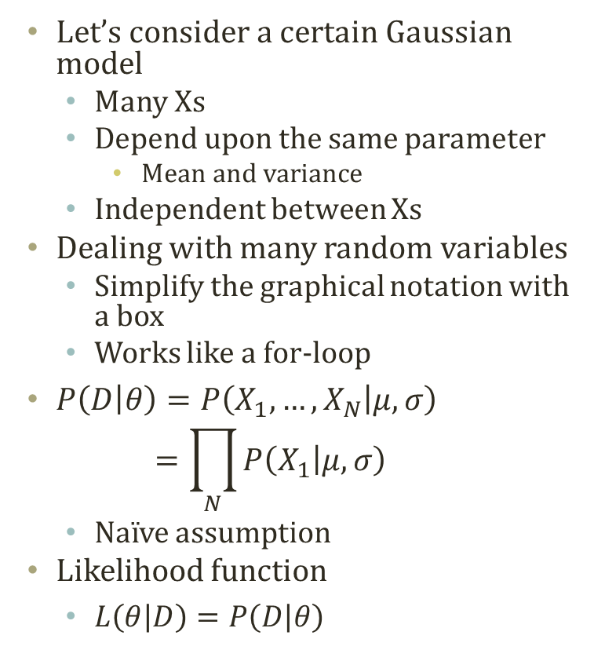
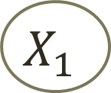

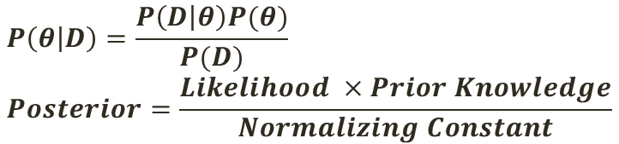
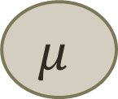

Plate Notation
$$P\left(θ | D\right)=\frac{P\left(D | θ\right)P(θ)}{P(D)} \\ Posterior=\frac{Likelihood ×Prior Knowledge}{Normalizing Constant}$$
$$μ$$
$$σ$$
Let’s consider a certain Gaussian model
  Many Xs
  Depend upon the same parameter
    Mean and variance
  Independent between Xs
Dealing with many random variables
  Simplify the graphical notation with a box
  Works like a for-loop
$P\left(D | θ\right)=P\left(X_{1},…,X_{N} | μ,σ\right)$
$=\prod_{N}{P\left(X_{1} | μ,σ\right)}$
  Naïve assumption
Likelihood function
  $L\left(θ | D\right)=P\left(D | θ\right)$
$$X_{1}$$
………..
$$X_{N}$$
$$μ$$
$$σ$$
$$X_{i}$$
i=1..N

